Slide 1
Training a speech recognizer using data from speech Synthesis
Group 6
Ravi Kappagantu
Ravi Prakash
Ashutosh Singh
Shashank Agrawal
Senthil Kumar
Dr. Prasanta Kumar Ghosh (prasantg@iisc.ac.in)

Slide 2



Pipeline, Data Sources & Pre-trained model
2
ASR Model
1
Pre-trained TTS
ASR Training
Input Text
3
Test Set
Process Flow Diagram
1
LibriSpeech ASR Corpus (link)
2
NeMo TTS – Multi-speaker Text2Speecf pre-trained model by Nvidia (link)
3
LibriSpeech ASR Corpus – Hold Out Data (link)

Slide 3
Data Pre-processing
Spectrograms
<Add sample spectrogram from the notebooks here>
MFCCs
<Add sample MFCC from the notebooks here>
<Add other details like hyper-params here>

Slide 4
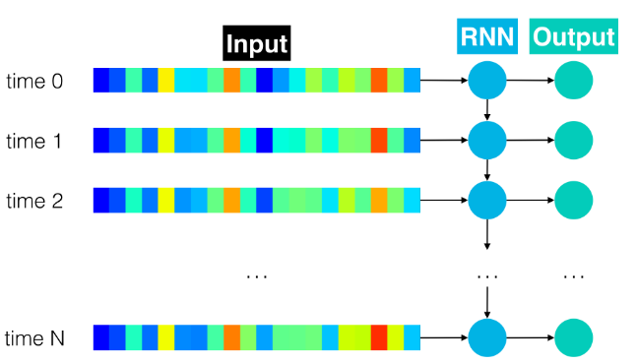
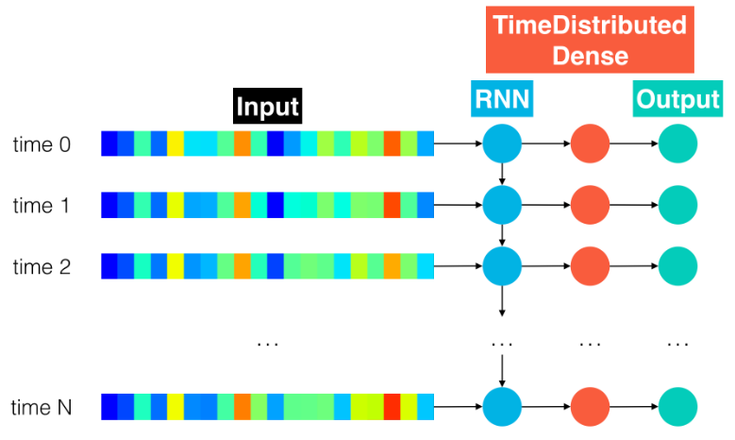
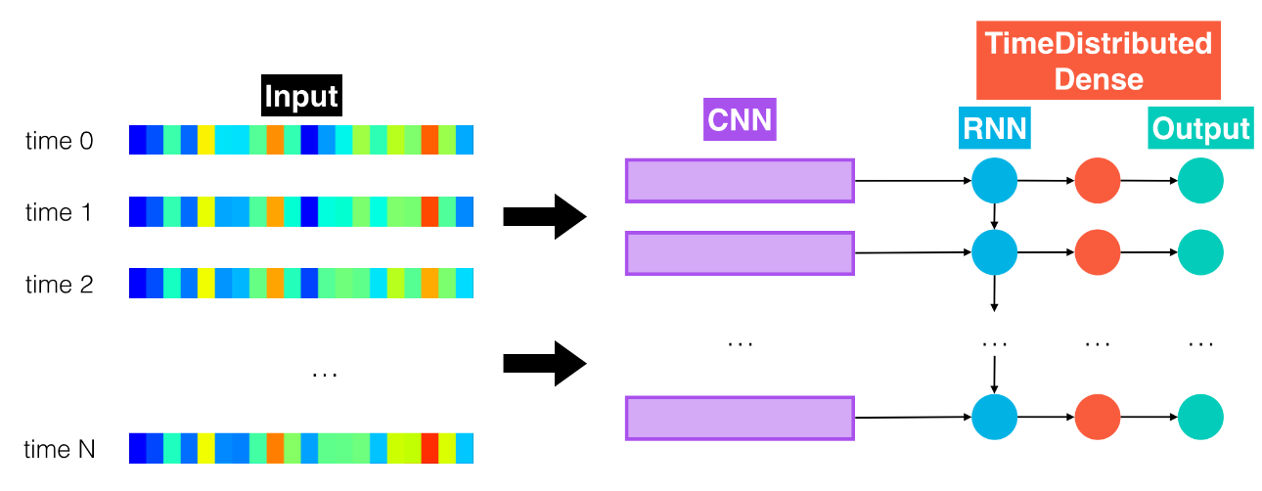
ASR Training
RNN
RNN + TimeDistributed Dense
CNN + RNN + TimeDistributed Dense
Bidirectional RNN + TimeDistributed Dense
CNN + RNN + TimeDistributed Dense + Dropout

Slide 5
Add Training Convergence charts here

Slide 6
Model Performance & Conclusions
Model | Word Error Rate
1
2
3
4
5
6

Slide 7
Appendix

Slide 8
Title of your capstone project
Name of your Supervisor from IISc
Details of the Datasets
Pre-processing steps
Method/Experiment highlighting the choice of your Model
The Performance Metrics
Conclusions

Slide 9
######Model 0: RNN
######Model 1: RNN + TimeDistributed Dense
######Model 2: CNN + RNN + TimeDistributed Dense
######Model 3: Deeper RNN + TimeDistributed Dense
######Model 4: Bidirectional RNN + TimeDistributed Dense

